Slide 1
COVID-19: Raw Material Impact in the Coating Industry in Ecuador
by Rafael G Fernandez
Hypothesis:
In March 2020, Covid-19 cases began to be detected throughout the South American region. One of thre most affected countries by this lethal virus was Ecuador. Based on the knowledge we have in the Coatings Industry, I think that the impact of Covid in Ecuador would be negative in reference to the imports of raw materials for the coating sector.
Using the import records of three companies that represent 80% of the total sales of finished products, I have performed the following analysis to determine if this hypothesis can be verified.

Slide 2
Dependencies and Setup
import warnings
warnings.filterwarnings("ignore")
import pandas as pd
import numpy as np
import datetime
import numpy as np
import matplotlib
import matplotlib.pyplot as plt
import seaborn as sns
sns.set(color_codes=True)

Slide 3
Reading files and store into Pandas data frame
file_one_df = pd.read_excel("Pinturas_Condor.xlsx")
file_two_df = pd.read_excel("Pinturas_Ecuatorianas.xlsx")
file_three_df= pd.read_excel("Pinturas_Unidas.xlsx")
covid_data_df=pd.read_csv("covid-data.csv")

Slide 4
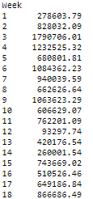
Converting Date into weeks
Input:
imports_df['Date']=pd.to_datetime(imports_df['Date'])
imports_df['Week']=imports_df['Date'].dt.week
imports_df.groupby('Week')['Qty'].sum()
imports_df.groupby('Week')['U$ CFR Tot'].sum()
Output:
Etc.

Slide 5
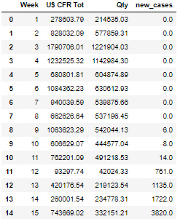
Merging custom information with Covid-19 cases
Input:
#total_unified_df
# total_imports_df.merge(total_covid_df, how="outer", on='Week')
total_unified_df=pd.merge(
total_imports_df,
total_covid_df,
how="outer",
on="Week"
)
total_unified_df = total_unified_df.fillna(0)
total_unified_df.head(53)
Output:
Etc.

Slide 6
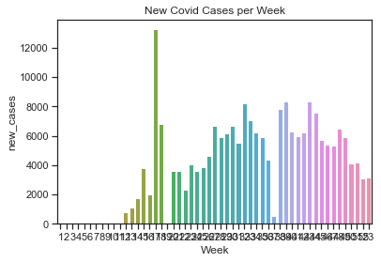
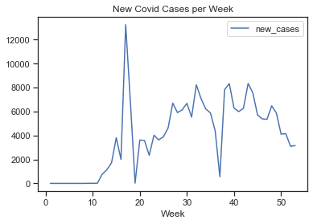
Covid cases analysis
# cases per week
sns.barplot(x=total_unified_df["Week"], y=total_unified_df["new_cases"])
pd.set_option('max_columns', 53)
pd.set_option('max_rows', 10)
sns.set(style="ticks")
plt.title('New Covid Cases per Week');
total_unified_df.plot.line(x='Week', y='new_cases')
plt.title('New Covid Cases per Week');

Slide 7
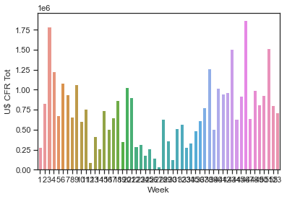
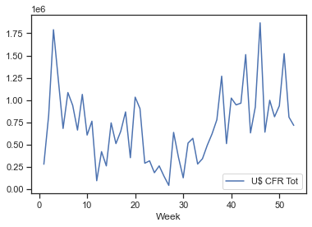
Total imports (USD) analysis
sns.barplot(x=total_unified_df["Week"], y=total_unified_df["U$ CFR Tot"]);
total_unified_df.plot.line(x='Week', y='U$ CFR Tot');

Slide 8
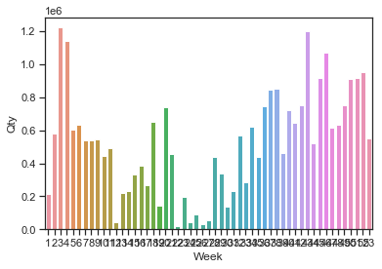
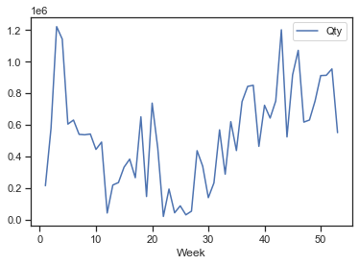
Total imports Qty (Kgs) analysis
sns.barplot(x=total_unified_df["Week"], y=total_unified_df["Qty"]);
total_unified_df.plot.line(x='Week', y='Qty');

Slide 9
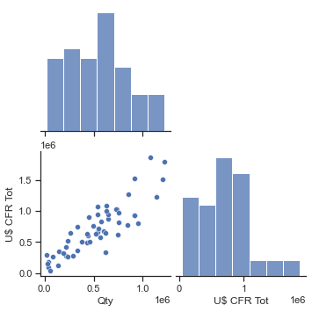
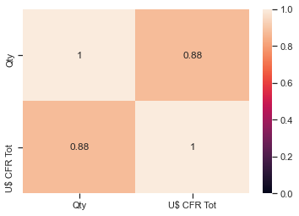
Total vs Qty
sns.pairplot(total_unified_df[["Qty", "U$ CFR Tot"]], corner=True);
sns.heatmap(
total_unified_df[["Qty", "U$ CFR Tot"]].corr(),
annot=True,
vmin=0,
vmax=1
);

Slide 10
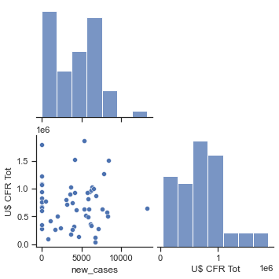
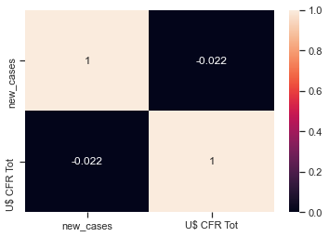
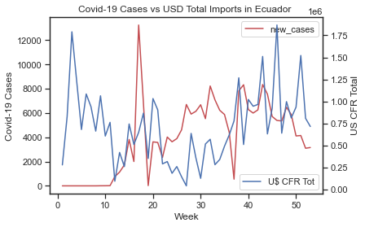
Case vs Total
sns.pairplot(total_unified_df[["new_cases", "U$ CFR Tot"]], corner=True);
sns.heatmap(
total_unified_df[["new_cases", "U$ CFR Tot"]].corr(),
annot=True,
vmin=0,
vmax=1
);
fig,ax = plt.subplots()
total_unified_df.plot.line(x='Week', y='new_cases',ax=ax,c='r')
ax2=plt.twinx()
total_unified_df.plot.line(x='Week', y='U$ CFR Tot',ax=ax2)
ax.set_ylabel("Covid-19 Cases")
ax2.set_ylabel("US CFR Total")
plt.title("Covid-19 Cases vs USD Total Imports in Ecuador ")

Slide 11
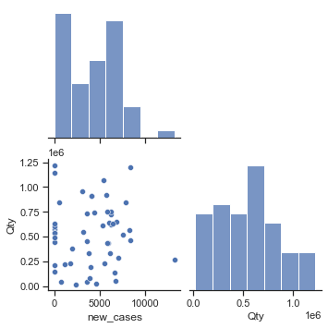
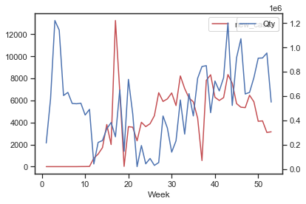
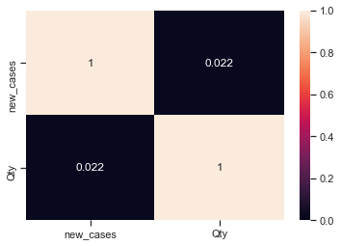
Cases vs Qty
sns.pairplot(total_unified_df[["new_cases", "Qty"]], corner=True);
sns.heatmap(
total_unified_df[["new_cases", "Qty"]].corr(),
annot=True,
vmin=0,
vmax=1
)
fig,ax = plt.subplots()
total_unified_df.plot.line(x='Week', y='new_cases',ax=ax,c='r')
ax2=plt.twinx()
total_unified_df.plot.line(x='Week', y='Qty',ax=ax2);

Slide 12
Summary
Analyzing the information we have obtained from the data record from customs office in Ecuador and World Data Record Case by countries affected by COVID-19, we can see the following:
The highest peak of Coviod-19 in Ecuador ocurred between April 20th and April 26th of 2020, however that the lowest importation values in USD were obtained during June 29th and July 5th.
The period of time between April 20th and June 29th is equivalent to 10 weeks.
We can observe that the amount of raw material in Kg arriving to the port maintains a correlation with the value in USD even at the highest peak of the pandemia.
The biggest volume of product in USD and Kg that arrives to the country is arriving from Colombia and the USA, so we can not use the transit time as an argument to justify a delay or slow down period. From the USA to Ecuador there is a transit time of 8 days. Colombia and Ecuador share borders and Transit time between the two countries is between two to four days.
In conclusion I could not find a correlation between New Covid-19 Cases and Amount of Raw Materials imported in Kg or USD for the Coating Industry. Seeing the results of these graphs,is possible to say that having people in quarantine or working from their homes has motivated the population to make repairs and paint the place where they work or live, so the impact of Covid-19 over the Coating Industry is not noticeable.

